Slide 1


Predicting the Lifetime of Grinding Stones on a Train
Group 5
Mo Cheng, Umesh Nair
ML Tlachac, Valerie H. Tuzel
Notes:
ML. Hello, we are group 5, and we will talking about predicting the lifespan of grinding stones.

Slide 2
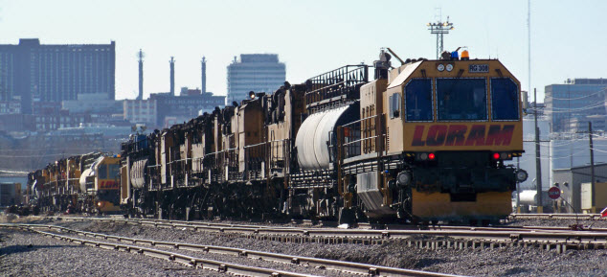
What is a grinding train?
http://www.loram.com/
Notes:
ML. ‘Let me start by asking, Has anyone heard of a grinding train?’, Raise hands. Answer question.

Slide 3
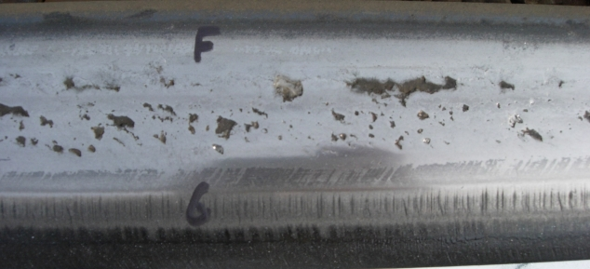
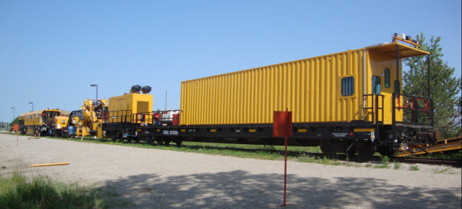
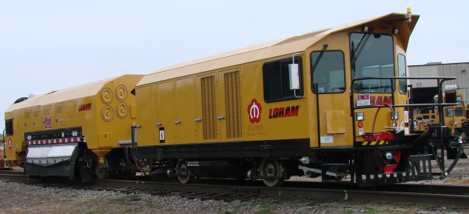
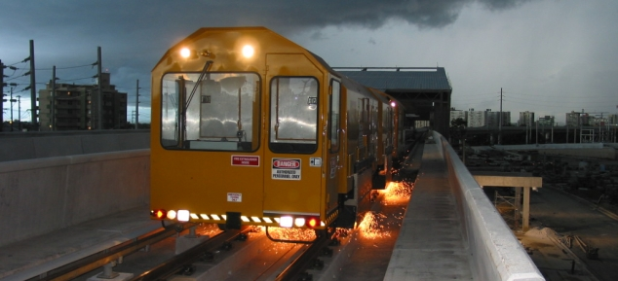
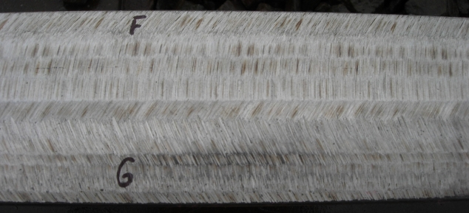
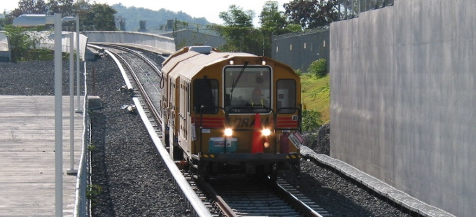
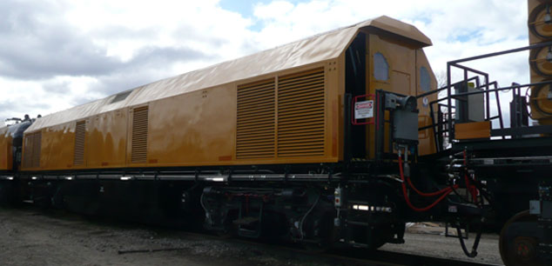
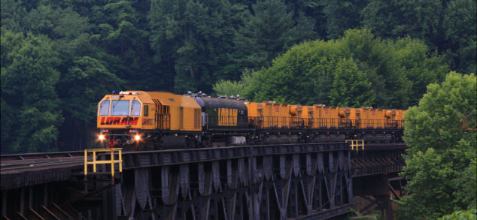
The Process
Trains use Track
Cracked Track
Grinding Train
Repaired Track
Challenge 1
http://www.loram.com/
Notes:
ML

Slide 4
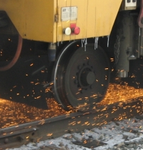
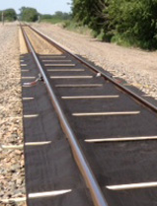
The Problem
Company
Context
Problem Statement
Loram is a leading supplier of railway track maintenance machinery and services in North America
Loram collects data on each grinding stone used but no prior analysis has been conducted on that data
How long will a grinding stone last?
http://www.loram.com/
Notes:
ML. Can anyone guess how long the average grinding stone lasts in hours? 5.5 hours

Slide 5
The Data
Cleaning
Variables
11280 observations
52 → 22 variables
Variables removed:
Company Specific
Constant value
High collinearity
Variables adjusted:
Stone lifetime
Distance traveled
20 numeric and 2 categorical variables
Stone Lifetime in Minutes
Distance Traveled in Miles
Position on Train (3)
Percent of Time at an Angle (7)
Programmed Amps at an Angle (7)
Average Programmed Amps
Actual Amps/Programmed Amps
Month
Notes:
ML. Let’s talk about the data

Slide 6
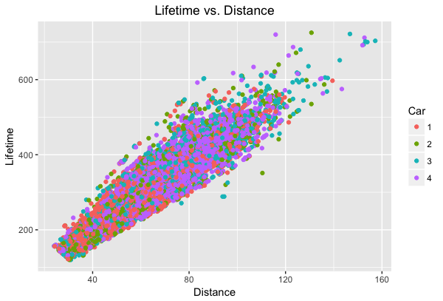
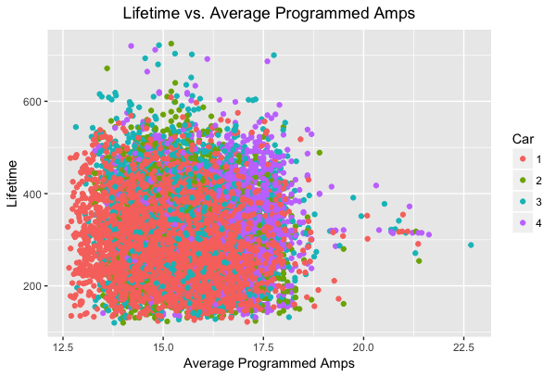
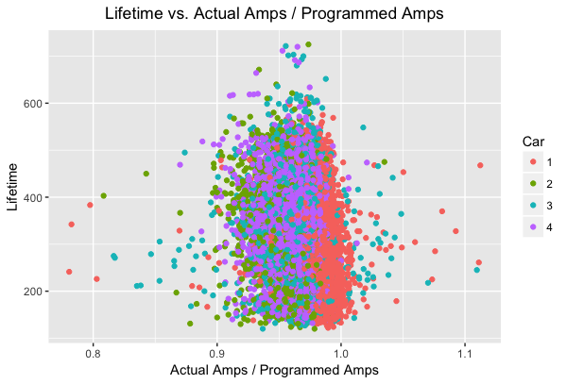
Data Visualizations
Notes:
ML. Before we started modeling, we looked at the relationship between lifetime and other variables.

Slide 7
Principal Component Regression
Partial Least Squares
Bagging
Random Forest
Random Forest with PCA
Best subset selection
Interactions
Linear Regression
Elastic Net
Dimension Reduction
Tree
Methods
Ensemble Methods
Lasso
Ridge
Tree
Recursive Partitioning
Notes:
Mo.

Slide 8
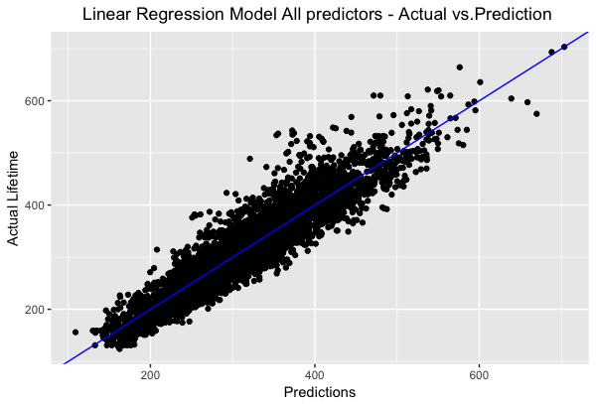
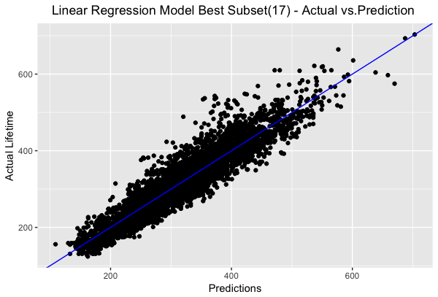
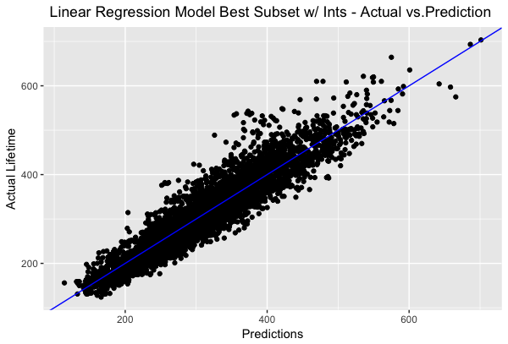
Linear Regression
Tried:
1
2
3
4
Model Includes | Adjusted R^2 | Test RMSE
Distance | 83.94% | 37.095
All predictors | 85.85% | 34.914
Best subset | 85.79% | 34.898
Interactions | 85.95% | 34.777
2
3
4
Notes:
Mo.

Slide 9
Method | Test RMSE
Linear Regression | 34.777
Notes:
Mo

Slide 10

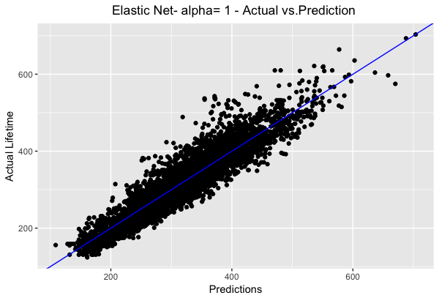
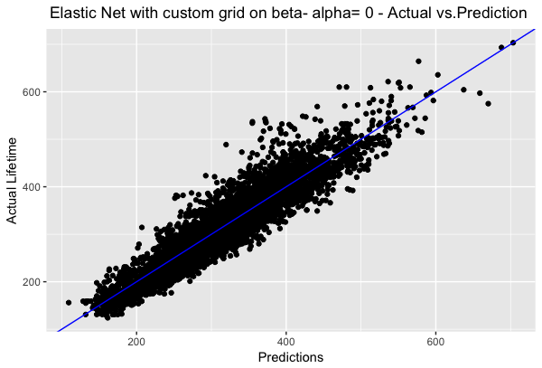
Elastic Net
Cross validation on alpha and beta | Cross validation on alpha and beta on a custom grid
Alpha = 1, Lasso | Alpha = 0, Ridge
Test RMSE = 34.943 | Test RMSE = 34.920
Notes:
Umesh.
Custom range of beta’s that were fed into R.

Slide 11
Method | Test RMSE
Linear Regression | 34.777
Elastic Net | 34.920

Slide 12
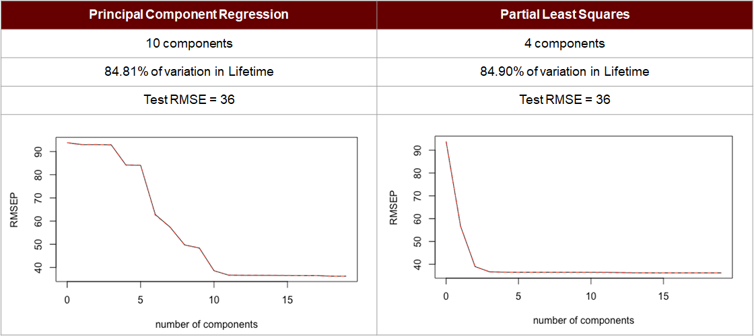
Dimension Reduction

Slide 13
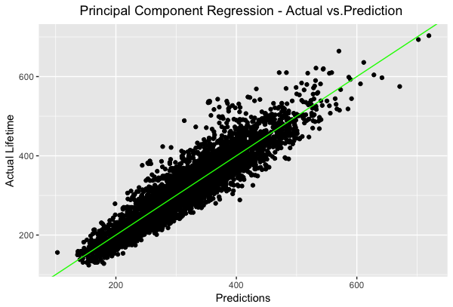
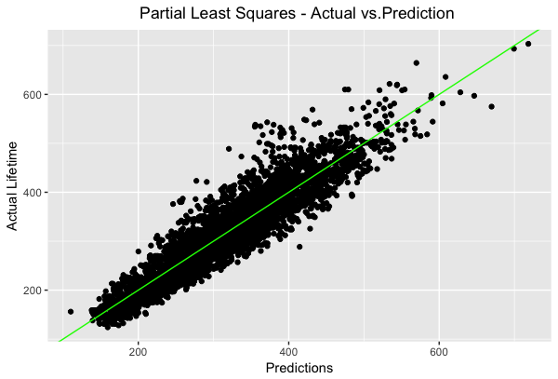
Dimension Reduction
Notes:
Very similar.
Expected better results.
So followed Prof’s Emdad’s suggestion.
Remove categorical, PCA, add back in categorical.

Slide 14
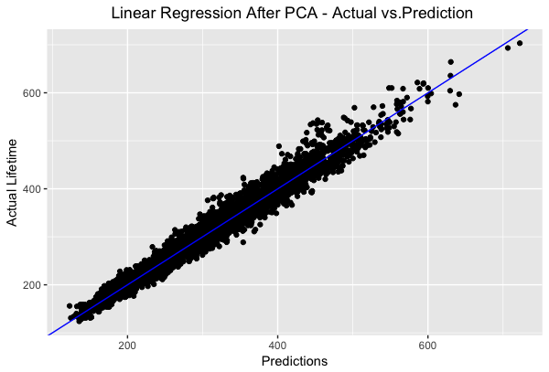
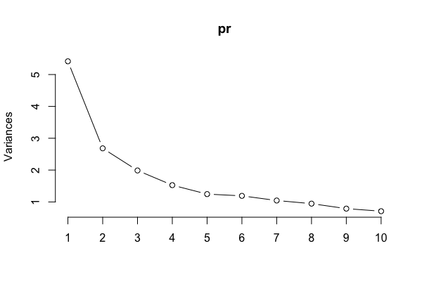
Dimension Reduction
Principal components computed manually using ‘prcomp’ while ignoring the categorical variables.
Linear regression after applying PCA (10 components) and adding back one of
the categorical variables.
Test RMSE = 18.352
Notes:
Last week prof mentioned abt applying pca on the numerical variables and then bringing in the categorical ones.

Slide 15
Method | Test RMSE
Linear Regression | 34.777
Elastic Net | 34.920
Linear Regression after PCA | 18.352

Slide 16
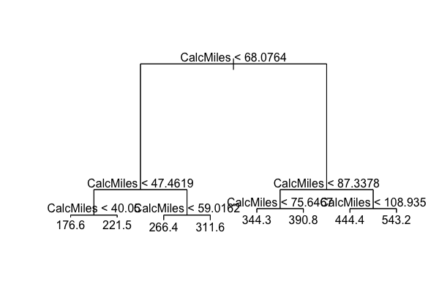
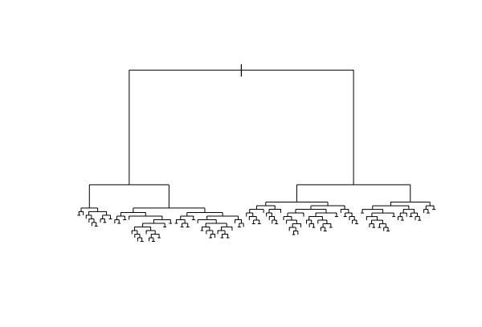
Tree Methods
Tree (shallow)
Test RMSE = 39.257
Recursive partitioning (rpart)
Test RMSE = 36.111
Notes:
Valerie.

Slide 17
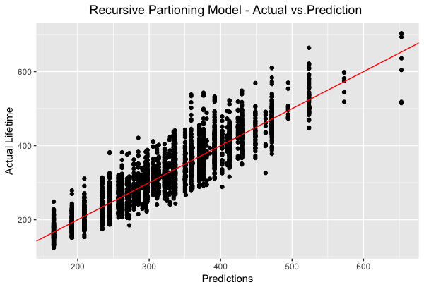
Tree Methods
Recursive partitioning (rpart)
Test RMSE = 36.111
Notes:
Valerie.

Slide 18
Method | Test RMSE
Linear Regression | 34.777
Elastic Net | 34.920
Linear Regression after PCA | 18.352
Recursive Partitioning | 36.111

Slide 19
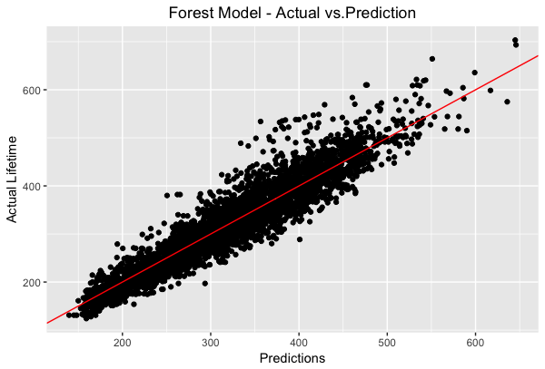
Ensemble Methods
Tried:
Bagging, mtry = p = 22, Test RMSE = 32.595
Random Forest, mtry = 10, Test RMSE = 32.152
Random Forest (ranger), mtry = 11, Test RMSE = 32.146
Notes:
Valerie.

Slide 20
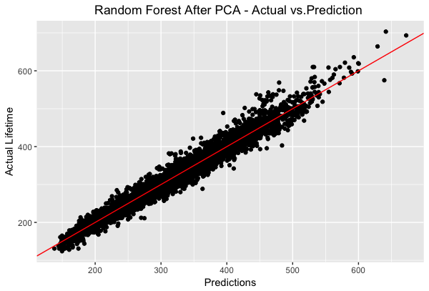
Ensemble Methods
Tried:
Applied Random Forest (ranger) to data transformed with PCA (10 components), mtry = 6, Test RMSE = 18.8814
Notes:
Valerie.

Slide 21
Method | Test RMSE
Linear Regression | 34.777
Elastic Net | 34.920
Linear Regression after PCA | 18.352
Recursive Partitioning | 36.111
Random Forest after PCA | 18.881

Slide 22
Method | Test RMSE
Linear Regression | 34.777
Elastic Net | 34.920
Linear Regression after PCA | 18.352
Recursive Partitioning | 36.111
Random Forest after PCA | 18.881

Slide 23
Conclusion
max growth
Linear Regression after PCA
Test RMSE = 18.352
Notes:
Valerie.

Slide 24
Future Directions
Feature Engineering
Other Methods
Left/Right position
Snow potential
Percent of time at negative angles
Percent of time at extreme angles
Average amps at negative angles
Average amps at extreme angles
Gradient Boosting on data treated with PCA
K Nearest Neighbors (KNN)
Notes:
Valerie.
Add variables to the linear regression model with Distance.
If the stones are on the Left/Right, if there is a snow pot in the month, Percent of Time at neg angles, percent of time at extreme angles -> Does not decrease RMSE.
Snow potential decreases RMSE.
Percent of time at angles and average amps at angles: 14 variables -> 4 variables

Slide 25
Thank You!
Questions?
Notes:
Valerie

